Slide 1
Create Project by Team 2 March 2025
Calculator

Slide 2
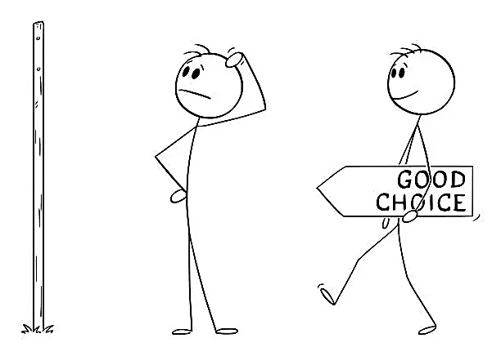
Why We Select This Project?
It helps in learning Python
Writing a calculator is a great way to practice fundamental programming concepts like loops, conditionals, and functions.
It’s a useful utility
A calculator program is simple yet practical, and it reinforces how user input, mathematical operations, and output work together in coding.

Slide 3
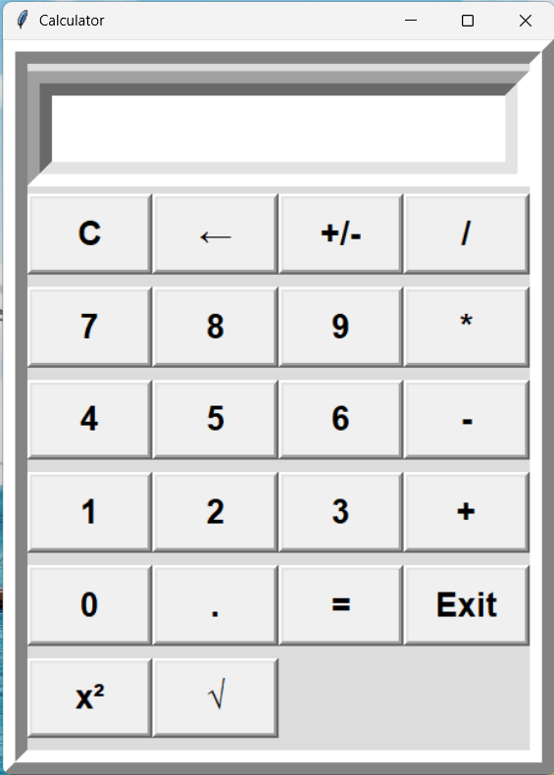
CONTENTS
Calculator Include Few Parts:
Display Menu
Functions
Keyboard

Slide 4
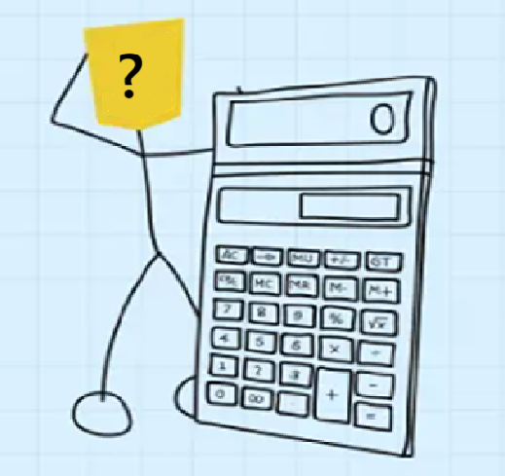
Calculator Codes

Slide 5
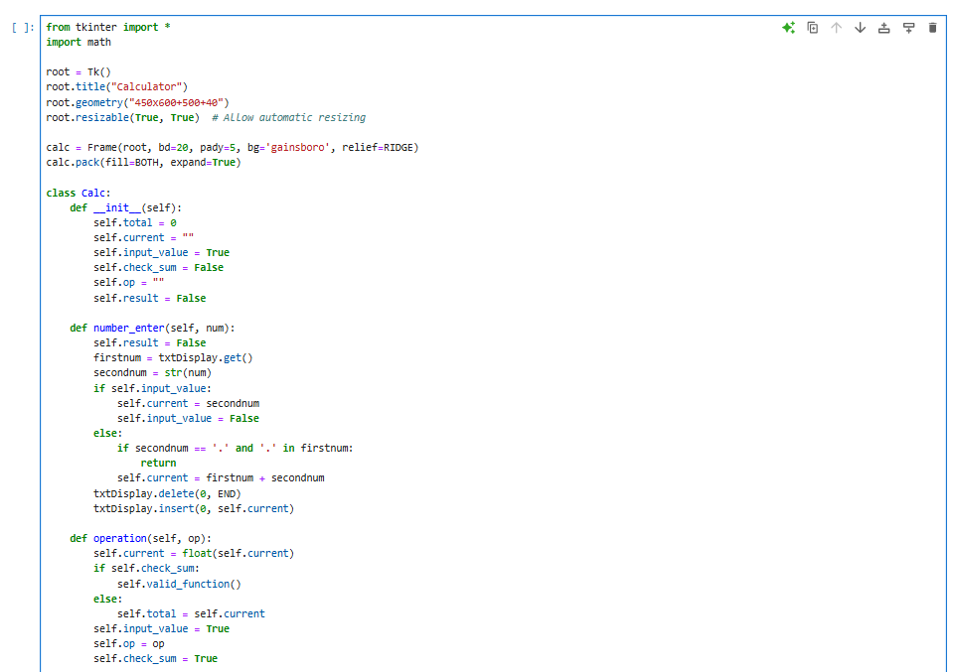
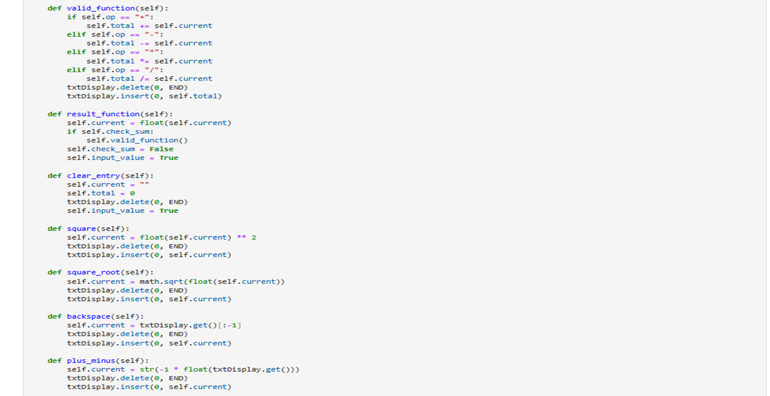
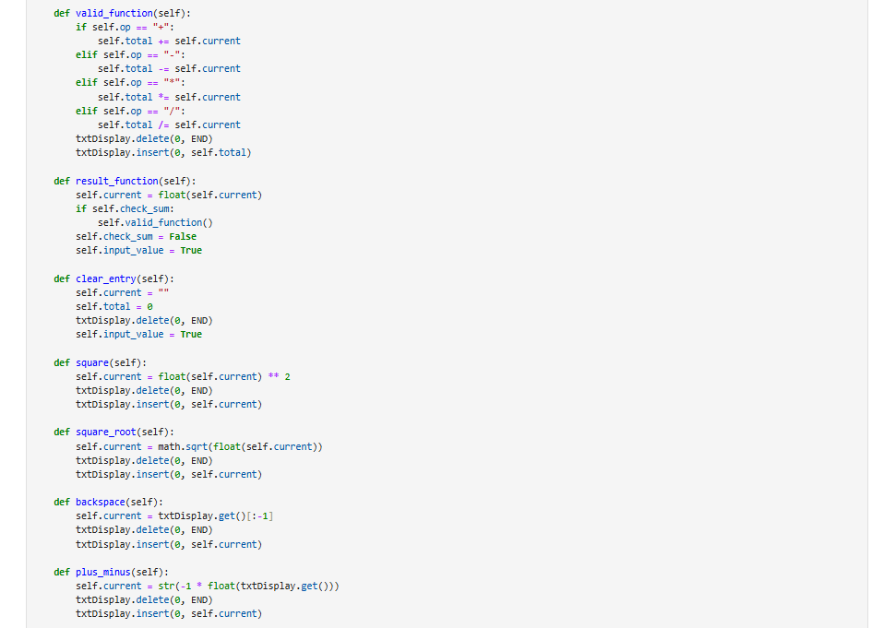

Slide 6
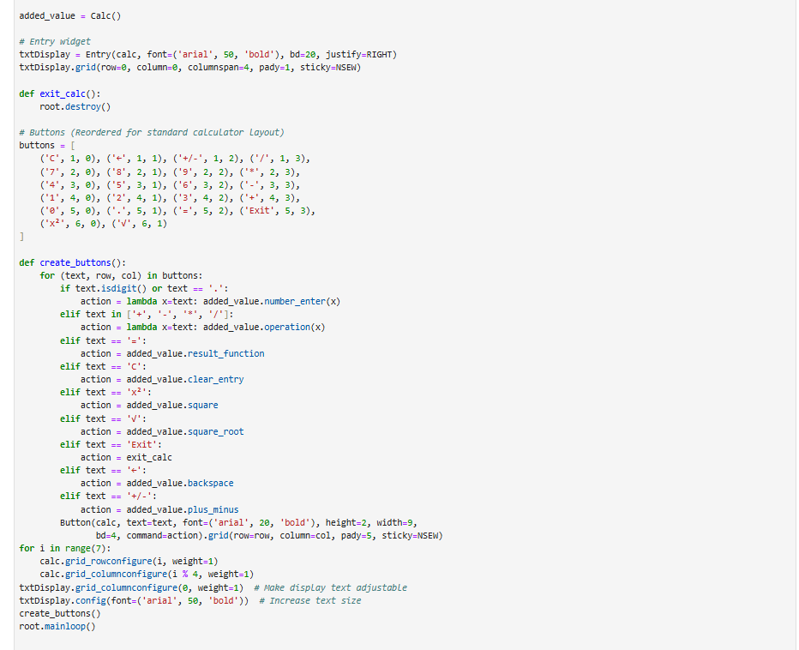

Slide 7
You Can Click on the Link to See Main Codes in Jupyter
LINK: Calculator Project- Main Code- Team 2

Slide 8
Members Team 2
Yaxian Zhang (presenter)
Samira Mozafarzadeh (create power point)
Elham Madani Sarighiyeh (create codes)
Yasas Thamara Wijethunga (create codes)
Yin Myo Khaing (create codes)
Ajah Kevin Abraham (create codes)

Slide 9
References
https://medium.com/@DataEngineeer/python-programming-projects-gui-based-basic-calculator-3bc3c982aad1
https://www.geeksforgeeks.org/python-simple-gui-calculator-using-tkinter/
https://www.studytonight.com/tkinter/calculator-application-using-tkinter
https://www.geeksforgeeks.org/python-dynamic-gui-calculator-using-tkinter-module/

Slide 10


